Slide 1

College Presentation
galileoweb.org/college/
Download this presentation on the above website
An Overview of the College Application Process for 2012 Seniors
BAI ZHEN, UC Berkeley
EMAIL: zhenb@galileoweb.org
(415) 749 3430 x3246
Monday-Thursday 9:30-6 PM

Slide 2

Your Story

Slide 3
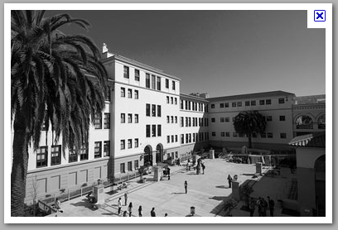
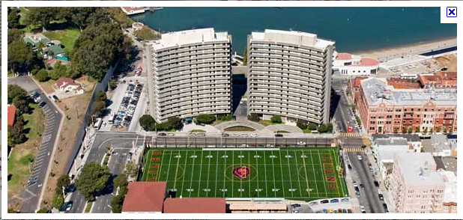

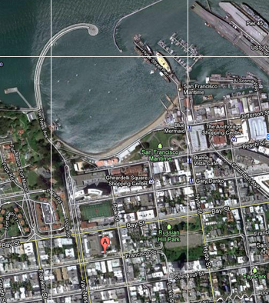

Slide 4
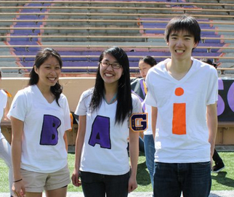
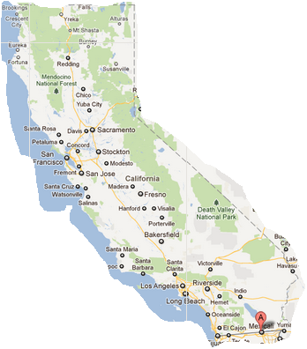
Bai’s story
* Mexicali & Calexico, California
* First-generation college student
* Low-income background
* Was not aware of resources, but work-hard
* UC Berkeley
Worked in AACE Educational Talent Search for the past five years, worked at Galileo for the past 3 years. Works really hard at Galileo for the students.
Enjoys working ☺

Slide 5
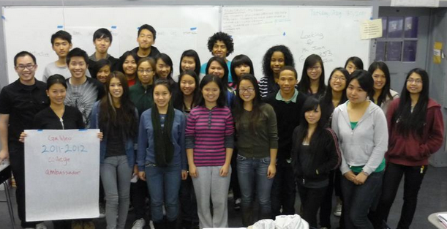

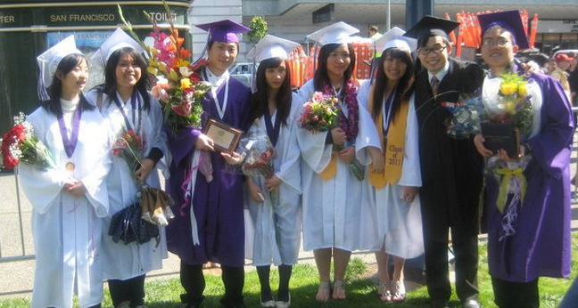
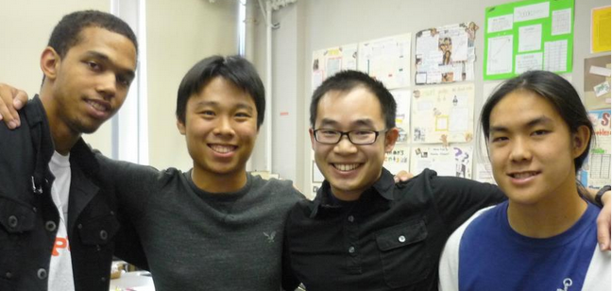
College Ambassadors
Helping Bai share college information with Galileo students.

Slide 6
Summary of Deadlines:
COLLEGE SYSTEM | Application Available | Application Deadline | Websites:
University of California | Oct. 1 | Wed, NOV. 30 | universityofcalifornia.edu
California State University | Oct. 1 | Wed, NOV. 30 | csumentor.edu
Private | LIVE! Now ☺ | Varies: Dec/Jan | commonapp.org
Community College | Around Feb/March 2012 | Submit ASAP | cccapply.org Assist.org

Slide 7
College Presentations
AFTER-SCHOOL in the Counseling office, 258F
Wed, Sept. 28 at 2 pm: San Francisco State University
Mon, Oct. 17 at 3 pm: Smith College
Thurs, Oct. 20 at 3 pm: USC & Whitman College
Mon, Oct. 24 at 3 pm: Amherst College
Tues, Oct. 25 at 3 pm: Dominican University of CA
Tues, Nov. 1 at 3 pm: UCLA
Thurs, Nov. 3 at 2 pm: CSU Sacramento
Wed, Nov. 9 at 2 pm: Cal Poly Pomona
College & Career Expo: College Fair: 60+ colleges
Friday, Oct. 14, from 9:30-11:30 a.m.
Including: UC, CSU, Private colleges, for a complete list of colleges, go here: galileoweb.org/college
UC Davis college campus field trip: Wed, Oct. 19

Slide 8
College Fair Tips
Before the fair, Research the colleges & ask yourself:
Answer the following questions:
Do you want to attend a two- or four-year institution? Co-ed or single sex?
What programs of study are you considering?
Do you wish to participate in any extra-curricular activities or athletics?
Do you want to attend a school in an urban, suburban or rural place?
Do you require any special services (i.e. tutoring, note takers, readers, TDD or interpreters)?
Discuss your college plans with your counselor, family, teachers and friends.
Research your colleges of interest on the Internet
9/27/2011
At the Fair...
1. Introduce yourself, ask questions.
2. Get college representative contact information for follow-up.

Slide 9

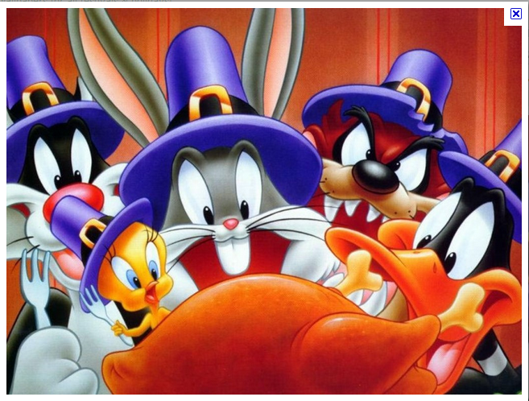
College Workshops, Rm 104
Tentative Dates, After-school in Computer Lab 104
Wednesday, Oct. 26
Wednesday, Nov. 2
Thursday, Nov. 10
Wednesday, Nov. 16
Thursday, Nov. 17
Monday, Nov. 21
Tuesday, Nov. 22
Monday, Nov. 28
Tuesday, Nov. 29
DEADLINE for UC/CSU on November 30.
Aim to finish applications before Nov. 22

Slide 10
College Admission Requirements
College System | A-G, GPA: SAT/ACT | Personal Statement | Letter of Recommendation | Activities
UC | Yes, GPA: 3.0 (weighted) SAT or ACT w/ writing * SAT 2:Optional | Yes | No | Yes
Private | Yes, but varies | Yes | Yes | Yes
CSU | Yes, GPA: 2.0 (weighted) SAT or ACT *eligibility index | None, unless applying to EOP | No, unless applying to EOP | No, unless applying to EOP
Community College | No | No | No | No

Slide 11
Fee-Waivers: College Apps
9/27/2011
4 fee-waivers for CSU
Apply online: only 1 chance to apply.
4 fee-waivers for UC
Apply online: when submitting the application
4 fee-waivers for Private Colleges
College-board fee-waiver: ask me for it.
Community College application: No FEE

Slide 12
EOP: Educational Opportunity Program
www.csumentor.edu/planning/eop/ Deadline varies: Jan. 31
9/27/2011
Designed to improve access and retention of historically low-income and educationally disadvantaged students.
The program provides admission and academic assistance. In many cases, the program offers financial assistance to eligible students.
IMPORTANT INFO REGARDING APPLYING FOR EOP: In order to begin an EOP application, you must first submit an online undergraduate application to the campus to which you are applying. EOP application requires two letter of recommendations

Slide 13
Letter of Recommendation
galileoweb.org/college/letter/
Bai deadline: Wed, Nov. 30th
9/27/2011
SPECIFIC TIPS FOR RECOMMENDATIONS
Typically, you’ll need two from teachers, one from counselor:
Put together a packet. Include: Bai’s Appraisal form, transcript, your resume, personal statement, etc.
2. Ask if they feel they can write a good recommendation. Ask teachers known you well, in core academic subject. At least four weeks.
3. After you ask for a recommendation, check back regularly with your teacher.
4. Lastly, show gratitude! ☺ Say, Thank you!

Slide 14



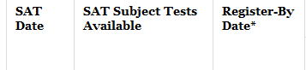
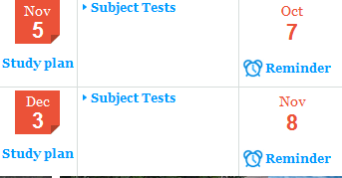
SAT, ACT Test Dates
9/27/2011
PRACTICE ACT ($5): Sign up with Ms. Marshman
Test Date: Wed, Oct. 5, sign up by Friday, Sept. 30
FREE SAT/ACT Practice (Online Resources): http://www.blinetestprep.com/sat/ for only SAT (practice exams)
http://www.number2.com/ for both ACT/SAT www.perfect800.com for SAT Math, http://www.snapwiz.com/galileo interactive study tools
http://sat.collegeboard.org/practice official SAT prep exam:
Last SAT and ACT to take is December. Some colleges might not accept Dec SAT scores. Example: San Jose State, San Luis Obispo, and San Diego State

Slide 15
Sending SAT/ACT Scores
Download guide: galileoweb.org/college/resources/satact/
COLLEGES look at your highest test scores
9/27/2011
SEND SAT scores:
Tips: Send most recent SAT scores, they’ll send all scores.
CSU: 3594, all CSU will receive score
UC: Send one UC, all will get it
Private: Need to send to all of them.
Test Dates | Send scores for FREE
SAT: Oct. 1 | Mon, Oct. 10
SAT: Nov. 5 | Mon, Nov. 14
SAT: Dec. 3 | Mon, Dec. 12
ACT: Oct. 22 | Wed, Oct. 26
ACT: Dec. 10 | Wed, Dec. 14
SEND ACT scores:
CSU: Send to one, use ACT Score Manager (on CSU Mentor website) to release scores to other CSU
UC: Send one UC, all will get it
Private: Need to send to all of them.

Slide 16
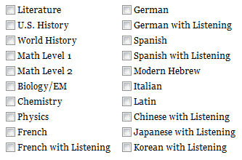
SAT II Subjects: Optional
9/27/2011
Some campuses may recommend SAT Subject Tests for specific majors: Highly recommended for Engineering & Science Majors
http://www.universityofcalifornia.edu/admissions/freshman/requirements/examination-requirement/SAT-subject-tests/

Slide 17
SAT vs. ACT
SAT I (Reasoning Test) | ACT
Writing--作文 | Writing--作文
Verbal--英文 | Verbal--英文
Math--數學 | Math--數學
 | Science Reasoning 科學推理
 | Reading--閱讀
9/27/2011
ACT: No penalty for wrong answers
SAT: Take away a ¼ of a point for wrong answers.

Slide 18
Subject Requirements
Complete “a-g” subjects: doorways.ucop.edu/list
a) 2 years of history/social studies
b) 4 years of English
c) 3 years of math
d) 2 years of lab science (one physical science & one biological)
e) 2 years of a language other than English: Chinese, Spanish, French
f) 1 year of a Visual or Performing Art course
g) 1 additional college prep elective course that falls within the a-f subjects
9/27/2011

Slide 19
What are the rules on repeating courses?
9/27/2011
A course in which a D/F is earned can be repeated with a course that has the same curriculum
If a C or better is earned, the original D/F will not be included in the GPA calculation. Only the new grade will be used in the GPA calculation.
Students must list all courses, including the original course, on their application.

Slide 20
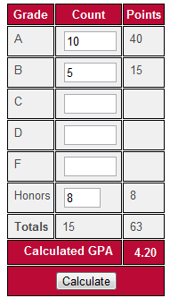
Calculating UC & CSU GPA
9/27/2011
Use 10th grade and 11th grade a-g classes
Count the # of semesters for honors/AP
A-G Course list: doorways.ucop.edu/list/
9th grade and 12th grade still matters!
Make up any D or F grades for A-G classes with Night-School & Cyber-High
Do not count: P.E, JROTC, Remedial class
Fall: American Democracy | In Progress (IP)
Spring: Economics |  | Plan (PL)

Slide 21
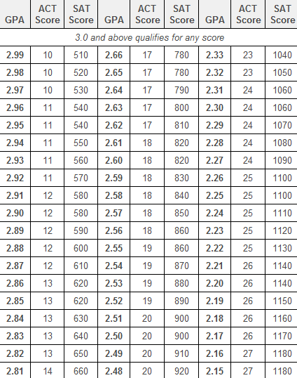
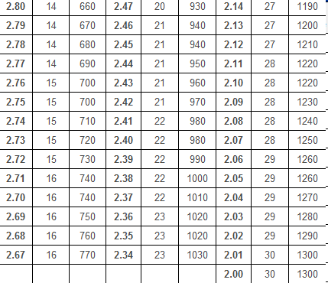
CSU Eligibility Table
http://www.csumentor.edu/planning/high_school/cal_residents.asp
9/27/2011
Below 2.0 does not qualify for regular admission
CSU uses only SAT scores for math and critical reading
Math + | Reading = 1200
May: 600 | May: 500
October: 500 | October: 600
GPA | ACT | SAT I
2.9 | 10 | 510
2.55 | 19 | 860
2. 0 | 30 | 1300

Slide 22
UC Review Process
Grade Point Average
3.0 for California Residents
Coursework
Complete any 11 UC-approved “a-g” courses prior to senior year
Complete all 15-course “a-g” subject pattern by the end of senior year
Courses must be completed with a grade of C or better
9/27/2011

Slide 23
Comprehensive Review
14 academic and personal factors including:
Grades and test scores and:
Quality of senior year program
Special talents, achievements & awards
Promise for leadership
Recent, marked improvement in academic performance
Significant community service
Participation in student government
Intensive study and exploration of other cultures
Participation in programs like AACE Talent Search (TRIO)
Full list of factors:
www.universityofcalifornia.edu/admissions/freshman/how-applications-reviewed/
This allows UC to go beyond grades and test scores and review each applicant fully based on everything in their application.
9/27/2011

Slide 24
Personal Statement
Great San Francisco Personal Statement Workshop Weekend: Oct. 29-30, 1-6 PM at Mission HS
Sign up here: 826valencia.org, click on calendar
9/27/2011
An opportunity for applicants to provide information that supports and enhances review process
Adds clarity, richness and meaning to application and completes the application
An admission decision is never based on the content of the personal statement alone

Slide 25
UC Personal Statement Prompt
Applicants are asked to respond to two prompts:
Describe the world you come from—for example, your family, community or school—and tell us how your world has shaped your dreams and aspirations.
Tell us about a personal quality, talent, accomplishment, contribution or experience that is important to you. What about this quality or accomplishment makes you proud and how does it relate to the person you are?
Word Count: 1,000 words total
9/27/2011

Slide 26

REMEMBER!

Slide 27
Important Tips
Remember your username & passwords
Check your e-mail & college-portal sites
Senior year grades still very important.
No D/F, make sure to keep up grades!
Get started early! Apply broadly!
Pick up a copy of your transcript, Ms. Chan

Slide 28

CSU: ELM/EPT exams
SIGN UP HERE to take exam at SFSU: http://www.sfsu.edu/~testing/eptelm.html
Entry-Level Math (ELM)/English-Placement Tests (EPT): You need to take the exams early, otherwise you won’t be able to sign-up for classes at CSU
Preparation: csusuccess.org
Early start:
Required for students who do not meet the ELM/EPT proficiency requirements
Program starts the summer before freshman yr.
Will be available at CSU-campus, community college & online.
Financial-aid available

Slide 29

Financial-Aid & Scholarship
A College Education is Affordable with Financial-Aid!!!!
FAFSA: Free Application for Federal Student Aid
Apply starting January 1, Deadline: MARCH 2
http://www.fafsa.gov/
CSS Profile (private colleges)
profileonline.collegeboard.com/
SCHOLARSHIPS:
Galileoweb.org/college/scholarships
AB 540 Resources: http://www.e4fc.org/
Family Income
# of Family Household
You can get:
Grants, Cal-Grant
Loans, Work-Study

Slide 30

Free application for Federal Student Aid: Fafsa.gov

Slide 31

How to Choose a College?

Slide 32

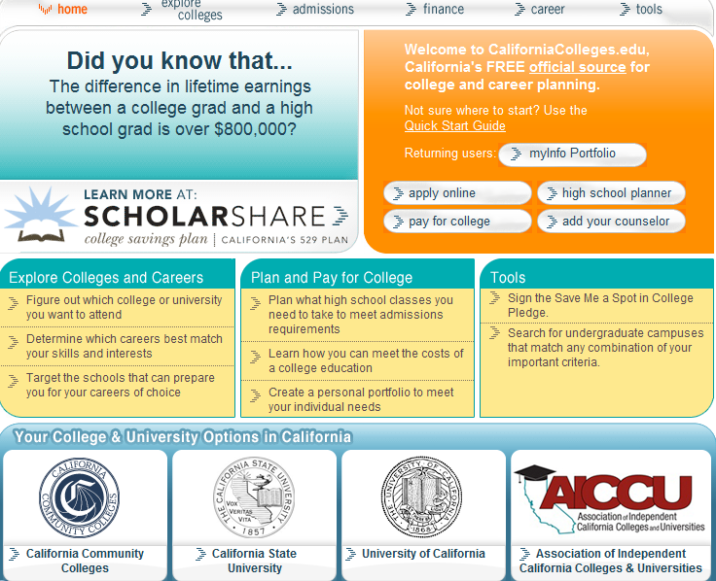
California Colleges

Slide 33
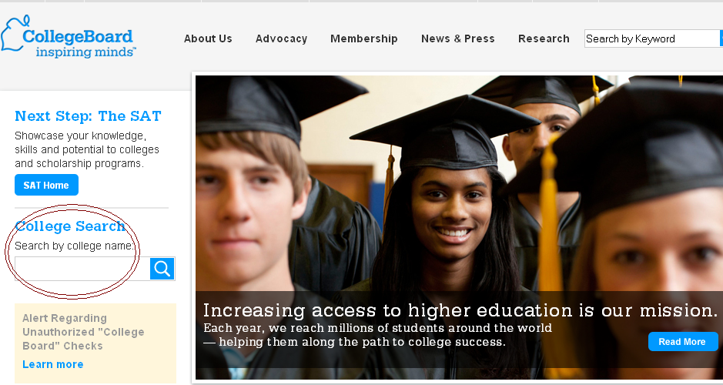
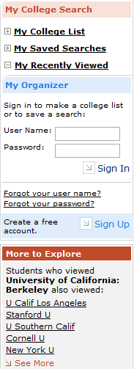
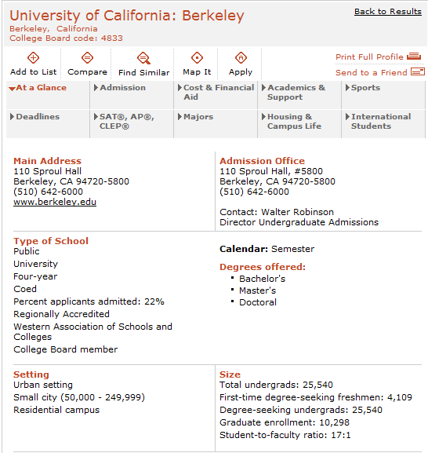
College Board:
http://www.collegeboard.org/
Factors to Consider:
Parental desire, friends
* Majors, Curriculum
Ideal Environment, Size
* Distance from Home, Location, Costs
What’s Important to You
Where you feel happy ☺

Slide 34
Community Colleges 100% acceptance rate Very affordable at $36/unit Many technical and vocational programs (e.g. Nursing, Culinary, etc.) Associate Degrees in some fields Have transfer agreements and guarantees with some CSUs, UCs, and private schools | California State University (CSU) Total of 23 campuses Impact campus vs. Non-impacted Campus Typically smaller class sizes than UC Focus on hands-on experience Most faculty are focused on teaching, not research Many are commuter campuses (limited housing)
University of California (UC) 9 undergraduate campuses (Irvine, Merced, Berkeley, Davis, San Diego, Riverside, Los Angeles, Santa Cruz, Santa Barbara) Typically large class sizes Focus on research Top research university Residential campus (guaranteed housing for freshmen) | Private Colleges and Universities More than 75 private schools in California alone (Stanford, USF,etc) Small teacher to student ratio Most professors teach classes, not TAs High graduation rate and can finish in four years Housing can be available all 4 years Admission requirements vary Can be very affordable with financial aid.

Slide 35
Pathways To California Higher Education
Doctorate/
Professional
Degree
Doctorate/
Professional
Degree
Graduate/
Professional
Schools
BA/BS Degrees
Awarded to
CCC Transfers:
Master’s
Degree
Master’s
Degree
Master’s
Degree
55-60% CSU
28-30% UC
20% Private
Senior
Bachelor’s
Degree
Bachelor’s
Degree
Bachelor’s
Degree
Upper
Division
Coursework
Admission Priority
to CCC Transfers
Admission Priority
to CCC Transfers
California Independent Colleges & Universities
Actively Recruit Transfer Students
Junior
Transfer Requirements:
GPA/Major/GE
Sophomore
Transfer/
Associate’s Degree
Lower
Division
Coursework
Freshman
Certificate
California Community
Colleges
(110 campuses)
California State
University
(23 campuses)
University of
California
(9 campuses)
California Independent Colleges
& Universities
(77+ campuses)
Recommended:
SAT For Athletes
SAT/GPA
SAT/GPA
SAT/GPA
High School Graduate
www.collegeofsanmateo.edu/transfer

Slide 36
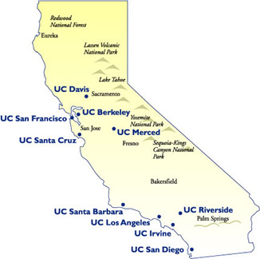
University of California
* University of California (UC)- 加 州 大 學
10 間學院:
UC Berkeley, UC Davis, UC Santa Cruz,
UC Merced, UC Santa Barbara
UC Irvine, UC Los Angeles,
UC Riverside, UC San Diego.
Graduate School: UC San Francisco (醫學院),

Slide 37
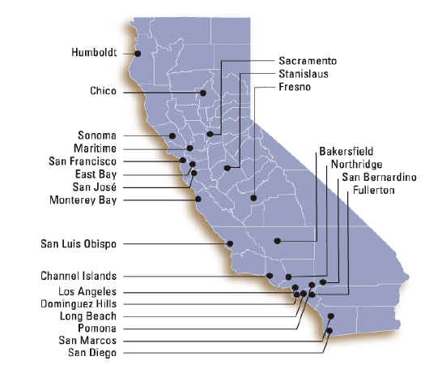
California State University
California State University (CSU)-加州州大學
23 間學院: San Francisco State University (local),
Non-Impacted: Monterey Bay, East Bay, Maritime, Stanislaus, Channel Islands, Dominguez Hills, Bakersfield
Impacted: San Jose, Sonoma, San Diego, Sacramento, Fresno, Chico, Humboldt, Northridge, Dominguez Hills, Pomona, San Marcos, LA
Impacted in all Majors: Long Beach, San Luis Obispo, and Fullerton

Slide 38
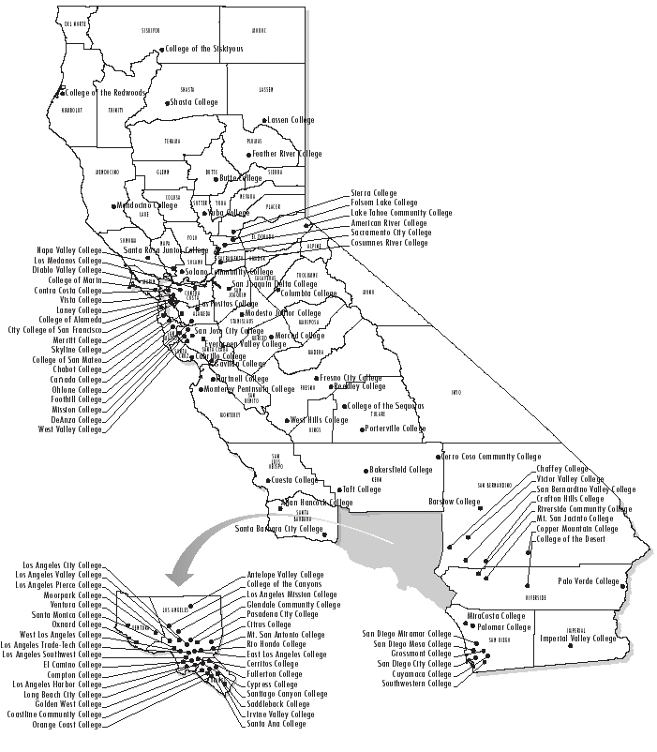
Community Colleges
112 colleges: City College of San Francisco (CCSF), Skyline, College of San Mateo, Laney College, etc.

Slide 39
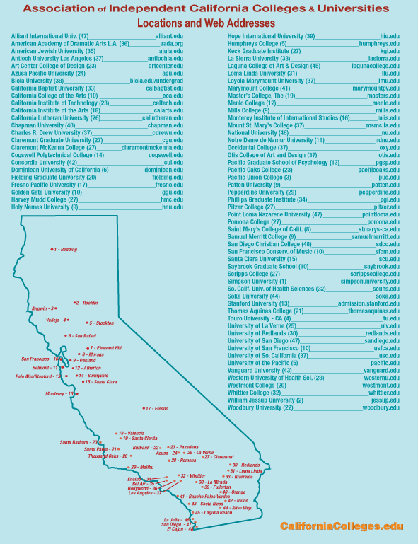
CA Private Colleges
* Smaller classes, etc.
75+ colleges: Stanford, University of San Francisco, University of Southern California, St. Mary, University of the Pacific, Dominican University of California, Mills College, Chapman,
And hundreds of private colleges outside of California:
Haverford, Harvard, Whitman, Mt. Holyoke, Smith, New York University, Amherst, Dartmouth, Knox, Whitman, Wesleyan, and many more!

Slide 40
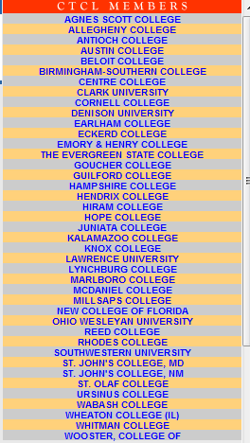

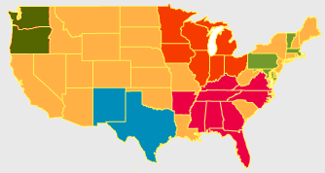
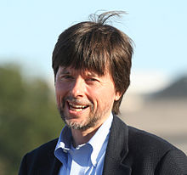

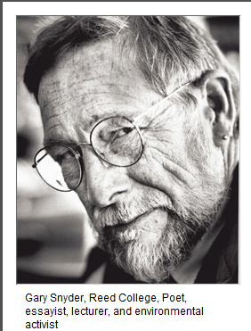

STUDENT-CENTERED: Develops lifelong love of learning and provides the foundation for a successful and fulfilling life beyond college.
Does It Matter Where You Go to College?
What You Do vs. Where You Go
http://www.ctcl.org/files/pdfs/does-it-matter-NYTimes113010.pdf
Ken Burns, director
Hampshire College
The key to success in college and beyond has more to do with what students do with their time during college than where they choose to attend.

Slide 41

Universityofcalifornia.edu/admissions/

Slide 42
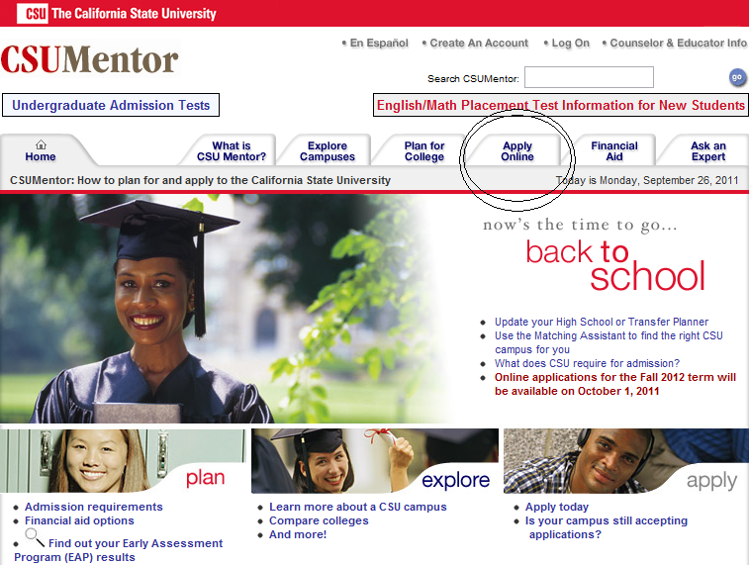
csumentor.edu

Slide 43


Slide 44
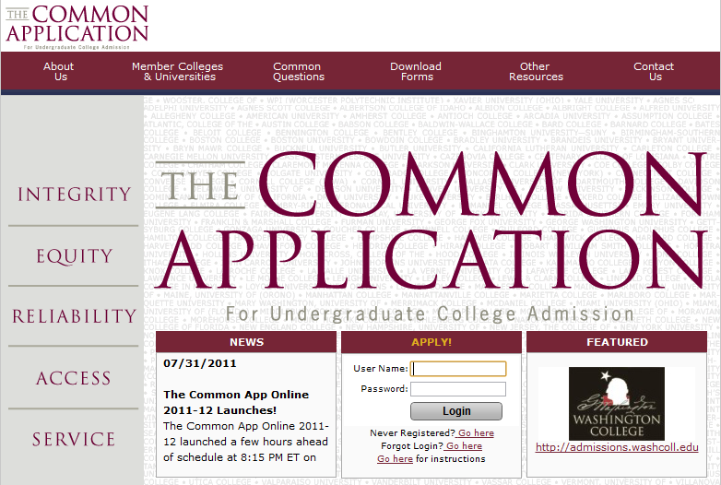
456 private colleges

Slide 45
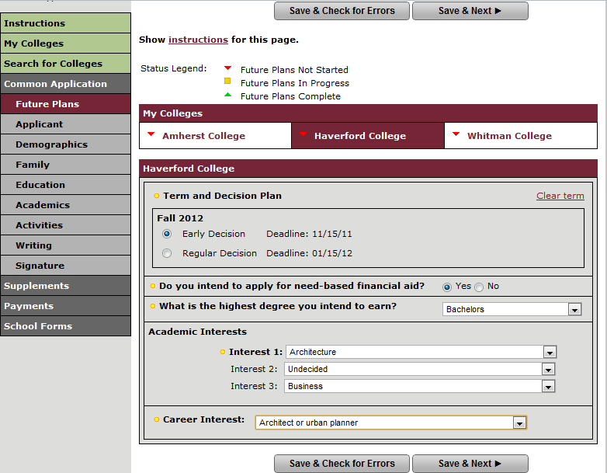
Early Decision, Action vs. Regular
Early Decision:
Binding (early deadlines)
Early-Action:
Non-Binding (early deadlines)
Regular Decision:
Normal Deadline, not binding

Slide 46
Community College
A wonderful open door of opportunity for all students
Open Access
Hundreds of programs & majors
Low-cost: $36/unit
Guaranteed Transfer Programs (TAG)
Support Services
Welcomes ALL students!
No SAT or GPA requirements

Slide 47
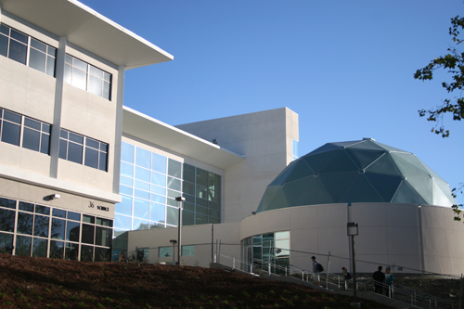
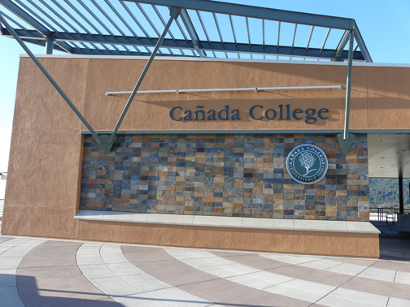
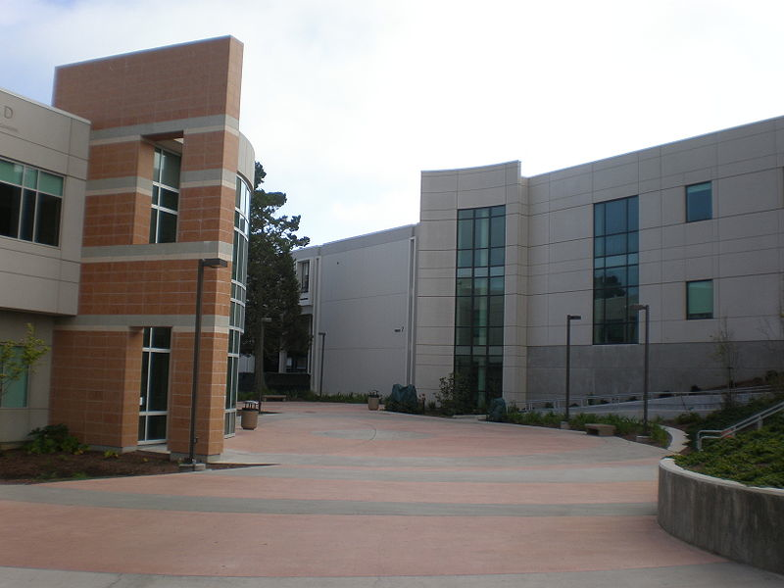

College of San Mateo
Canada College
Skyline College
CITY COLLEGE OF SAN FRANCISCO

Slide 48
The Admission Process
Application for admission - Top 100%
http://cccapply.org/
Placement Tests
Orientation
Counseling Assistance
Course Selection, Major Exploration,
Transfer Information
Support Services
Online Registration

Slide 49











Transfer
Benefits:
Complete the same course requirements as freshmen and sophomores at a university
To transfer: complete the equivalent to the universities freshmen and sophomore years at a local community college, so they can transfer as a junior to a university.

Slide 50

Admission Criteria for Transferring Juniors
To enter all UC’s, CSU’s,
and most private universities
Community College GPA, not High School GPA
No ACT, SAT, or even an “Eligibility Index”
Community College course work – Both general education & major requirements
assist.org – Online Students Transfer Information System

Slide 51
UC Student Retention & Graduation Rates
 | Freshmen | CCC Transfers
One-Year UC Persistence Rate | 92.4% | 92.2%
Elapsed Years to Degree | 4.2 | 2.4

Slide 52
Strong Priority is Given to Transfers from the California Community Colleges

Slide 53
The Importance of Major Preparation
Unlike freshmen, transfers enter halfway into a college degree. Students should work on their major classes and general education (G.E. or complete IGETC)
UC | GPA
Davis | 3.2
Irvine | 3.2
Merced | 3.0
Riverside | 3.0
San Diego | 3.5
Santa Barbara | 3.2
Santa Cruz | 3.0
All CCC have transfer centers, where students can find out: Guaranteed transfer agreements with UC, CSU, and Private Universities
UC TRANSFER AGREEMENT PROGRAM (TAG) 7 / 9
http://uctag.universityofcalifornia.edu/

Slide 54
‘Best Advice’ for YOU
9/27/2011
#1 Improve college readiness: take rigorous college prep courses throughout high school
Take math all four years in high school
Concurrent enrollment opportunities enable students to experience college while in high school
Take advantage of community college summer sessions following high school graduation
#2 Research your options
Visit www.assist.org
Not all CCCs offer the same programs or opportunities
Some CCCs offer more transferable courses in a major(s)
#3 Enroll in community college on time! Competition for courses
Start applying spring semester of 12th grade in order to register for classes when summer/fall registrations opens
Pay attention (check emails and other notifications)

Slide 55
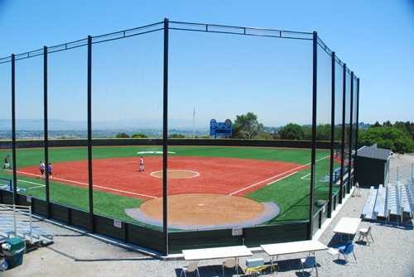


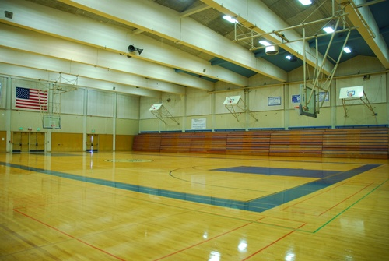
Sports & Study Abroad
Take advantage of intercollegiate athletics or foreign studies program

Slide 56
Students choose community college … specialized training
To receive specialized training or pursue a technical trade
Earn a certificate or an associate degree
Go directly into the world of work

Slide 57
Career Opportunities
Bio-technician
Business Manager
Computer Aided Drafter
Computer Support Specialist
Cosmetician
Dental Assistant
Hygienist
Interior Designer
Journalist
Medical Assistant
Nurse
Paralegal
Paramedic
Digital Imager
Drug Prevention Educator
Emergency Medical Technician
Fashion designer
Fire Fighter
Graphic Artist
Auto Mechanic
Police Officer
Real Estate Agent
Respiratory Technician
Surgical Technician
Telecommunication Technician
Web Designer

Slide 58
Comprehensive Support Services
Computer Lab
Disabled Students Program
English as a Second Language
Extended Opportunity Program & Services
Financial Aid
Health Services
Library Access
Math labs
Psychological Services
Reading Center
Scholarships
Student Employment
Tutorial Center
Writing Center

Slide 59

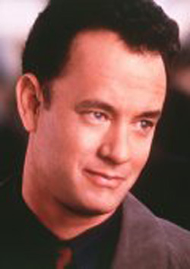
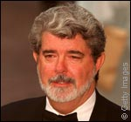

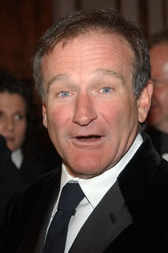
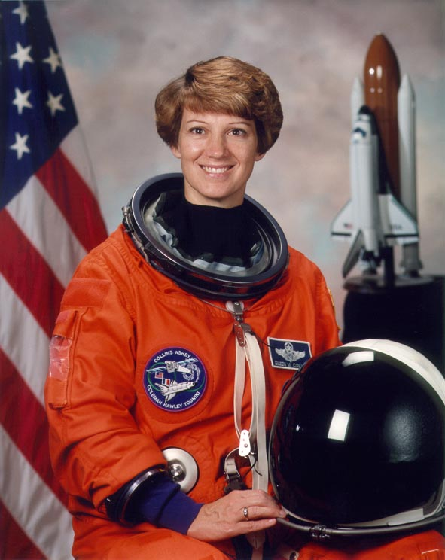
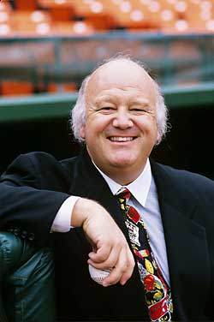
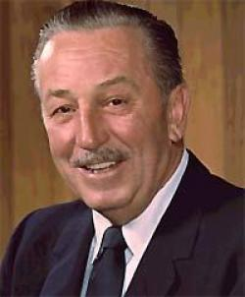
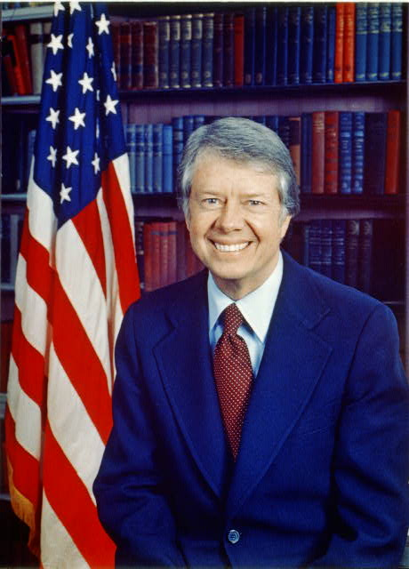
Who enrolls in Community College?
Tom Hanks
George Lucas
John Madden
Robin Williams
Eileen Collins
Walt Disney
Jimmy Carter
Jon Miller

Slide 60
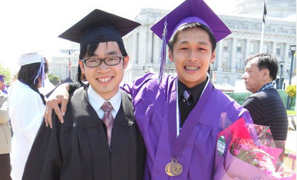
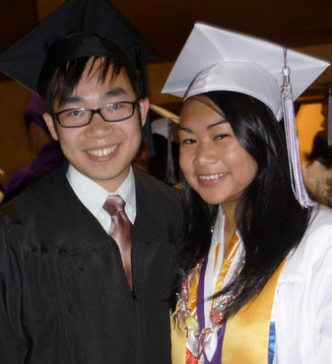
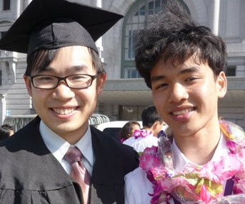
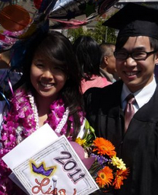
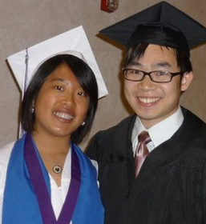
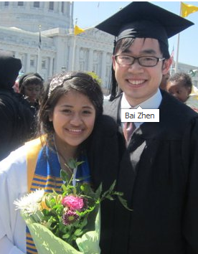
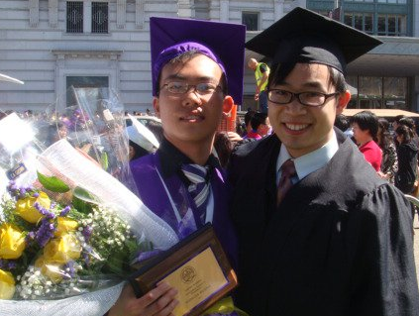
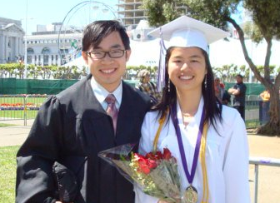
Thank YOU!
Students' motivation, ambition and desire to learn have a much stronger effect on their subsequent success
-Martha O’connell, executive director of CTCL

